Slide 1
Ericsson Internship Project Sprint 0 – Code Review
David Martin

Slide 2
System Design - Project Architecture
Web Client
Server
HTML 5
CSS
JavaScript
jQuery
Bootstrap
Http Request
Java EE
Springboot
Framework
using
Maven
Http Response
User Guide / Online Help
AJAX Requests
JSON Data

Slide 3
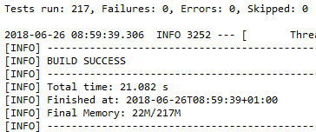
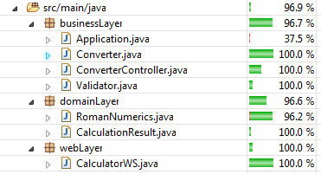
Test Strategy
Web Service:
Web Layer
Spock (Entrypoints)
Cucumber (UAT)
Business Layer
Spock (Mocking)
Domain Layer
Junit
Web Client
GUI – Selenium (Integration tests)

Slide 4
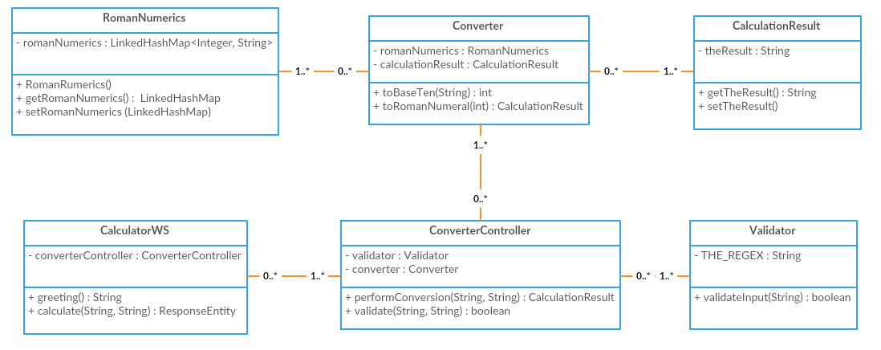
Class Diagram
Scrum Board : https://scrumy.com/DavidMartin_MScInternshipProject

Slide 5
Definition of Done
Acceptance criteria is verified during testing
90%+ Code coverage
All tests are automated and passing
The Master Branch shall always be in a working state (e.g. fully functional with all tests passing)

Slide 6
Validation of Rules of Roman Numerals
Regular Expression used for Validation :
^(M{0,3}(CM|CD|D?C{0,3})(XC|XL|L?X{0,3})(IX|IV|V?I{0,3})$
Example of hundreds validation
100: C matched by D?C{1} (with D not there)
200: CC matched by D?C{2} (with D not there)
300: CCC matched by D?C{3} (with D not there)
400: CD matched by CD
500: D matched by D?C{0} (with D there)
600: DC matched by D?C{1} (with D there)
700: DCC matched by D?C{2} (with D there)
800: DCCC matched by D?C{3} (with D there)
900: CM matched by CM
The same checking is then applied to 10’s and finally single roman numeral digits
Ref : https://stackoverflow.com/questions/267399/how-do-you-match-only-valid-roman-numerals-with-a-regular-expression

